Slide 1
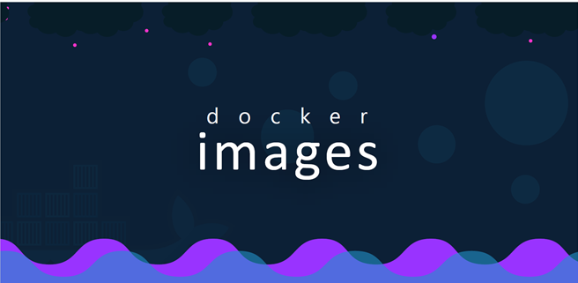

Slide 2
how to create your own image.
Why would you need to create your own image.
It could either be because you cannot find a component or a service that you want to use as part of your application
on docker have already or you and your team decided that the application you're developing will be dockerized for ease of shipping and deployment
Let’s containerize a simple web application that I have built using the python flask framework.

Slide 3
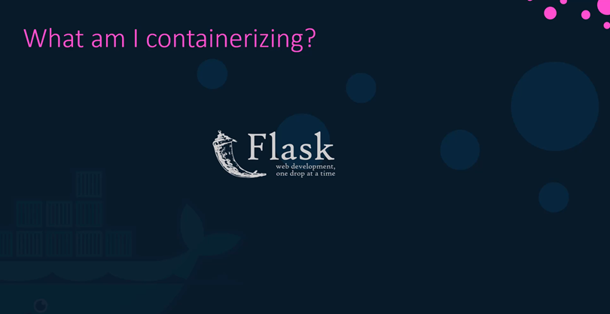

Slide 4
First we need to understand what we are containerizing or what application we are creating an image for and how the application is built.

Slide 5
So start by thinking what you might do if you want to deploy the application manually.
We write down the steps required in the right order and creating an image for a simple web application.

Slide 6
If I were to set it up manually I would start with an operating system like a ubuntu then update the source repositories using the apt command.
Then install dependencies using the apt command then install Python dependencies Using the PIP command
then copy over the source code of my application to a location like /opt
And then finally run the web server using the flask command.
.

Slide 7
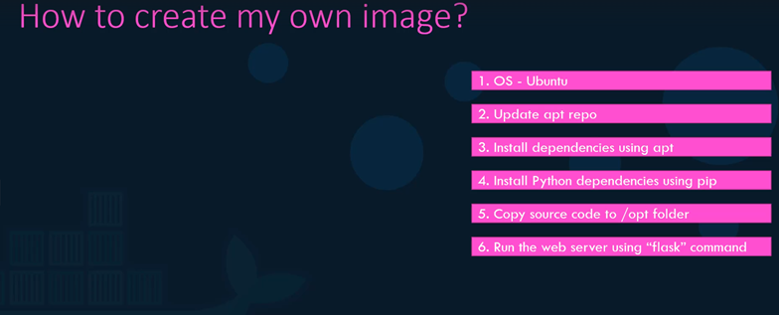

Slide 8
Now that I have the instructions create a docker file using these.
First create a docker file named Dockerfile and write down the instructions for setting up your application in it
such as installing dependencies where to copy the source code from and to and what the entry point of the application is etc.

Slide 9
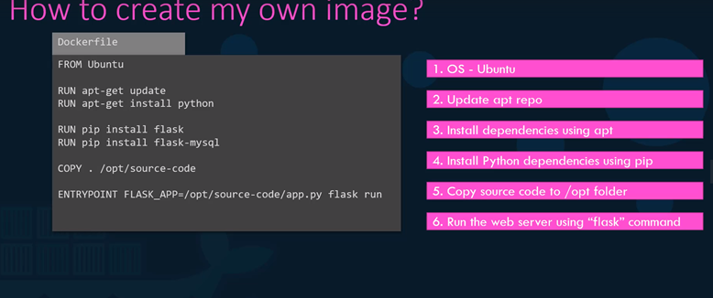

Slide 10
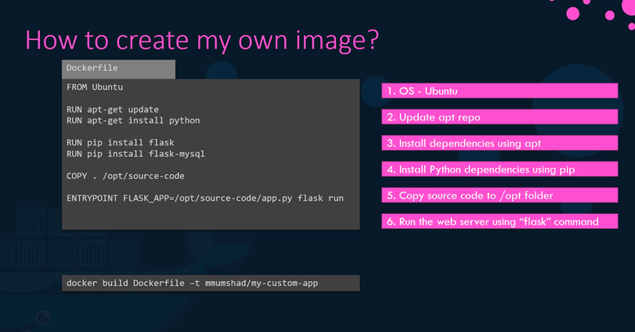

Slide 11
Once done build your image using the docker built command and specify the docker file as input as well as a tag name for the image.
This will create an image locally on your system

Slide 12
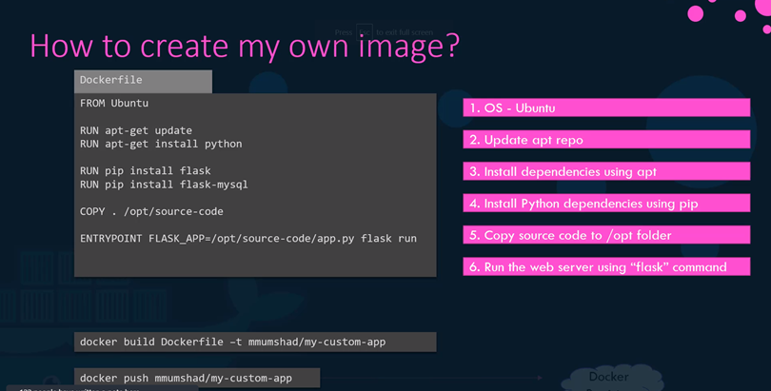

Slide 13
to make it available on the public Docker Hub registry
run the docker push command and specify the name of the image you just created.
In this case the name of the image is my account name which dockerid of docker hub followed by the image name
which is my custom app.

Slide 14
A closer look at that Docker file Docker file is a text file written in a specific format that Docker can understand.
It's in an instruction and arguments format.
For example in this Docker file everything on the left in CAPS is an instruction.
In this case from run copy and entry point are all instructions. Each of these instruct Docker to perform a specific action while creating the image. Everything on the right is an argument to those instructions.

Slide 15
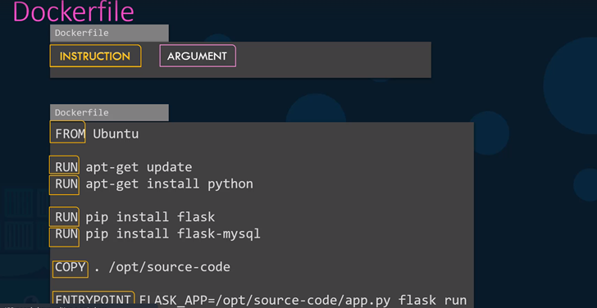

Slide 16
The first line from a ubuntu defines what the base OS should be focused container.
Every Docker image must be based off of another image.
Either an OS or another image that was created before based on an OS.
You can find official releases of all operating systems on Docker Hub.
It's important to note that all Docker files must start with a from instruction

Slide 17
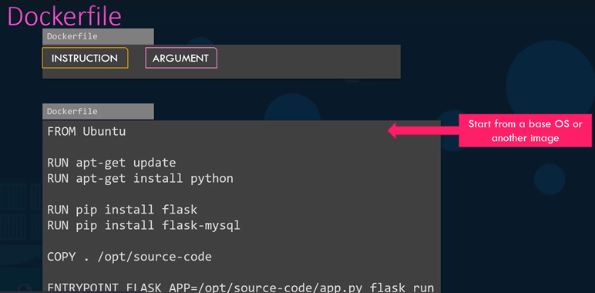

Slide 18
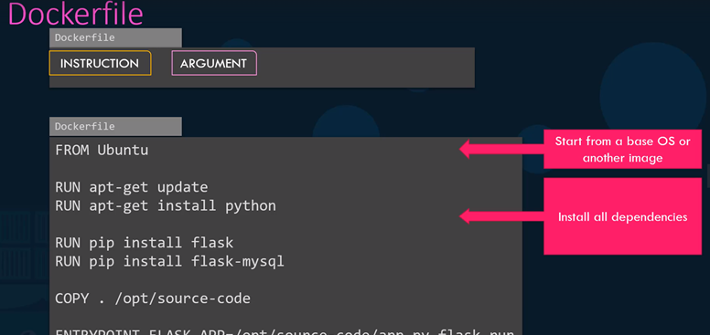

Slide 19
the run instruction
instructs Docker to run a particular command on those base images.
So at this point, Docker runs the apt-get update commands to fetch the updated packages and installs
required dependencies on the image

Slide 20
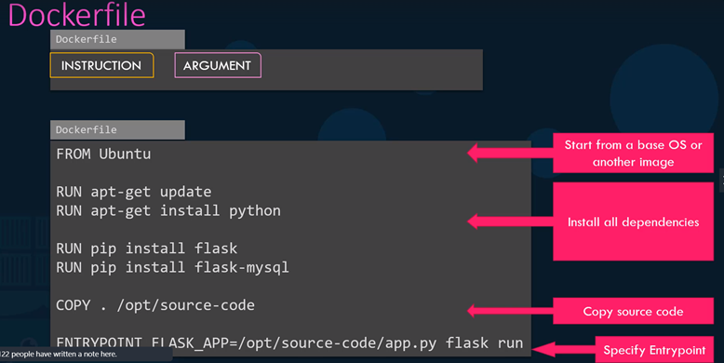

Slide 21
then the copy instruction copies files from the local system onto the Docker image.
In this case the source code of our application is in the current folder and I'll be copying it over to the location /opt/source-code inside the Docker image.
And finally entry point allows us to specify a command that will be run when the image is run as a container.

Slide 22
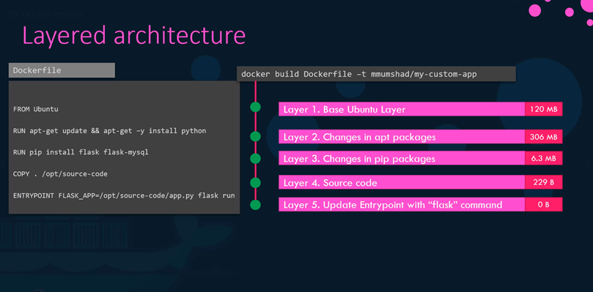

Slide 23
When Docker builds the images it builds these in a layered architecture
Each line of instruction creates a new layer in the docker image with just the changes from the previous layer.
And finally entry point allows us to specify a command that will be run when the image is run as a container.
When Docker builds the images it builds these in a layered architecture.
Each line of instruction creates a new layer in the docker image with just the changes from the previous -layer.

Slide 24
For example the first layer is a base Ubuntu OS followed by the second instruction that creates a second
layer which installs all the apt packages and then the third instruction creates a third layer with
the python packages followed by the fourth layer that copies the source code over and the final layer
that updates the entry point of the image.
Since each layer only stores the changes from the previous layer it is reflected in the size as well.
If you look at the base Ubuntu image it is around 120mb in size.
The apt packages that I install is around 300mb and the remaining layers are small.

Slide 25
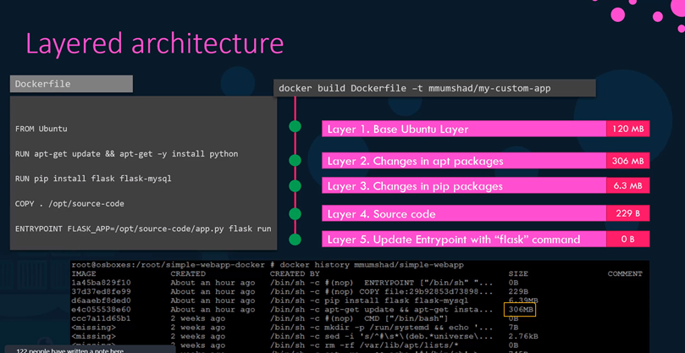

Slide 26
You could see this information if you run the docker history command followed by the image name

Slide 27
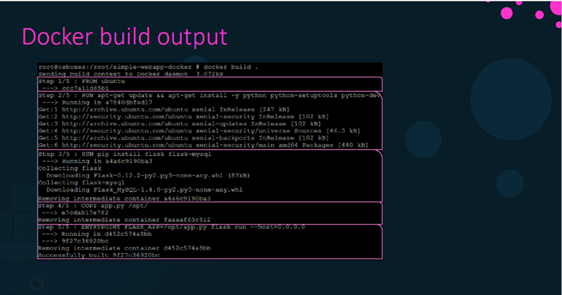

Slide 28
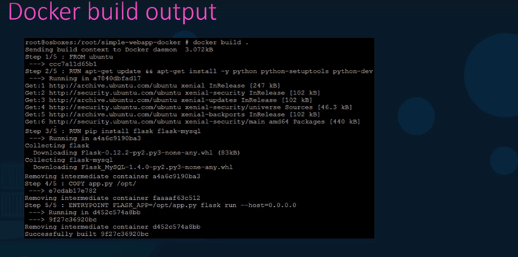

Slide 29
when you run the docker build command.
You could see the various steps involved and the result of each task.

Slide 30
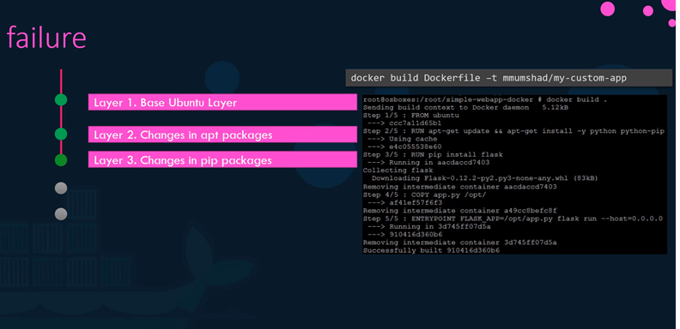

Slide 31
All the layers build are cached so the layered architecture helps you restart docker build from that particular step in case it fails or if you were to add new steps in the build process you wouldn't have to start over alll over again.
All the layers built are cached by Docker so in case a particular step was to fail for example in this
case step 3 failed and you work to fix the issue and re-run docker build it will re-use the previous
layers from cache and continue to build the remaining layers.

Slide 32
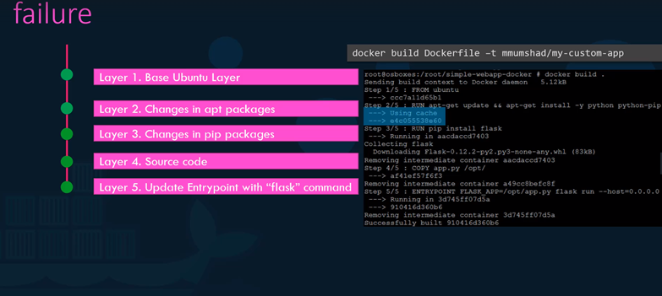

Slide 33
The same is true if you were to add additional steps in the docker file this way rebuilding your image
is faster and you don't have to wait for a docker to rebuilt the entire image each time.
This is helpful especially when you update source code of your application as it may change more frequently
only the layers above the updated layers needs to be rebuild.

Slide 34
